Slide 1
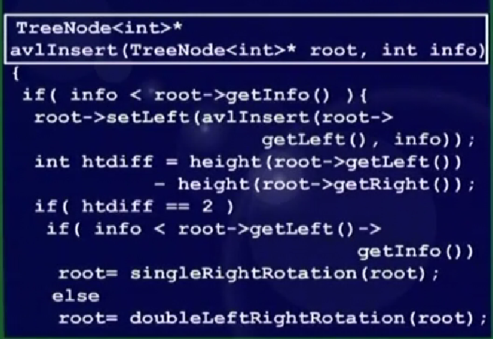
AVL Tree Building Example
AL

Slide 2
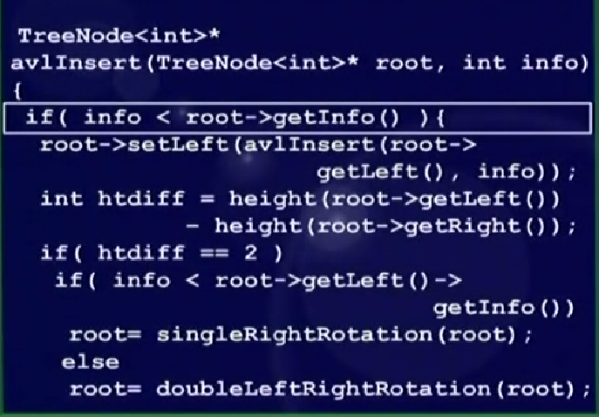
AVL Tree Building Example
AL

Slide 3
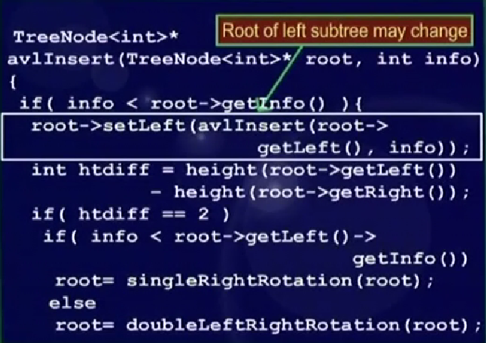
AVL Tree Building Example
AL

Slide 4
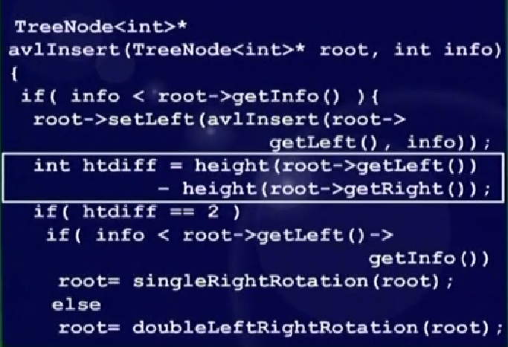
AVL Tree Building Example
AL

Slide 5
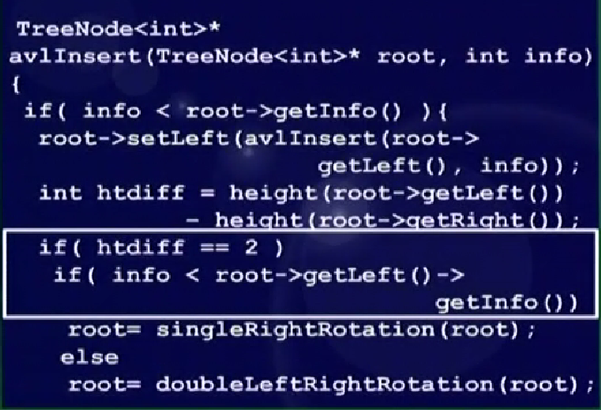
AVL Tree Building Example
AL

Slide 6
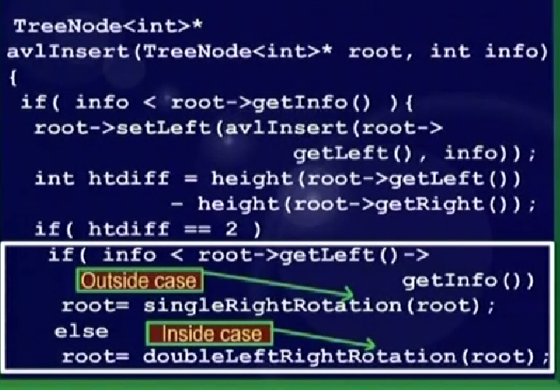
AVL Tree Building Example
AL

Slide 7
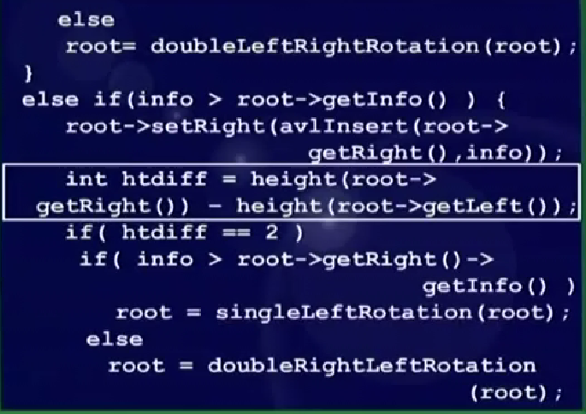
AVL Tree Building Example
AL

Slide 8
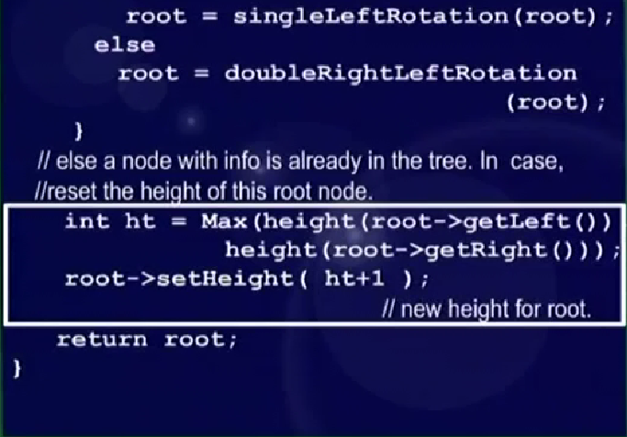
AVL Tree Building Example
AL

Slide 9
singleRightRotation

TreeNode<int>* singleRightRotation(TreeNode<int>* k2)
{
if( k2 == NULL ) return NULL;
// k1 (first node in k2's left subtree)
// will be the new root
TreeNode<int>* k1 = k2->getLeft();
// Y moves from k1's right to k2's left
k2->setLeft( k1->getRight() );
k1->setRight(k2);
// reassign heights. First k2
int h = Max(height(k2->getLeft()),
height(k2->getRight()));
k2->setHeight( h+1 );
// k2 is now k1's right subtree
h = Max( height(k1->getLeft()),
k2->getHeight());
k1->setHeight( h+1 );
return k1;
}
k₂
k₁
Z
Y
X
k₁
k₂
X
Z
Y
Notes:
Start of lecture 23

Slide 10
singleRightRotation
TreeNode<int>* singleRightRotation(TreeNode<int>* k2)
{
if( k2 == NULL ) return NULL;
// k1 (first node in k2's left subtree)
// will be the new root
TreeNode<int>* k1 = k2->getLeft();
// Y moves from k1's right to k2's left
k2->setLeft( k1->getRight() );
k1->setRight(k2);
// reassign heights. First k2
int h = Max(height(k2->getLeft()),
height(k2->getRight()));
k2->setHeight( h+1 );
// k2 is now k1's right subtree
h = Max( height(k1->getLeft()),
k2->getHeight());
k1->setHeight( h+1 );
return k1;
}

k₂
k₁
Z
Y
X
k₁
k₂
X
Z
Y

Slide 11
singleRightRotation
TreeNode<int>* singleRightRotation(TreeNode<int>* k2)
{
if( k2 == NULL ) return NULL;
// k1 (first node in k2's left subtree)
// will be the new root
TreeNode<int>* k1 = k2->getLeft();
// Y moves from k1's right to k2's left
k2->setLeft( k1->getRight() );
k1->setRight(k2);
// reassign heights. First k2
int h = Max(height(k2->getLeft()),
height(k2->getRight()));
k2->setHeight( h+1 );
// k2 is now k1's right subtree
h = Max( height(k1->getLeft()),
k2->getHeight());
k1->setHeight( h+1 );
return k1;
}
k₂
k₁

Z
Y
X
k₁
k₂
X
Z
Y

Slide 12
singleRightRotation
TreeNode<int>* singleRightRotation(TreeNode<int>* k2)
{
if( k2 == NULL ) return NULL;
// k1 (first node in k2's left subtree)
// will be the new root
TreeNode<int>* k1 = k2->getLeft();
// Y moves from k1's right to k2's left
k2->setLeft( k1->getRight() );
k1->setRight(k2);
// reassign heights. First k2
int h = Max(height(k2->getLeft()),
height(k2->getRight()));
k2->setHeight( h+1 );
// k2 is now k1's right subtree
h = Max( height(k1->getLeft()),
k2->getHeight());
k1->setHeight( h+1 );
return k1;
}
k₂
k₁
Z

Y
X
k₁
k₂
X
Z
Y

Slide 13
singleRightRotation
TreeNode<int>* singleRightRotation(TreeNode<int>* k2)
{
if( k2 == NULL ) return NULL;
// k1 (first node in k2's left subtree)
// will be the new root
TreeNode<int>* k1 = k2->getLeft();
// Y moves from k1's right to k2's left
k2->setLeft( k1->getRight() );
k1->setRight(k2);
// reassign heights. First k2
int h = Max(height(k2->getLeft()),
height(k2->getRight()));
k2->setHeight( h+1 );
// k2 is now k1's right subtree
h = Max( height(k1->getLeft()),
k2->getHeight());
k1->setHeight( h+1 );
return k1;
}
k₂
k₁
Z
Y
X

k₁
k₂
X
Z
Y

Slide 14
singleRightRotation
TreeNode<int>* singleRightRotation(TreeNode<int>* k2)
{
if( k2 == NULL ) return NULL;
// k1 (first node in k2's left subtree)
// will be the new root
TreeNode<int>* k1 = k2->getLeft();
// Y moves from k1's right to k2's left
k2->setLeft( k1->getRight() );
k1->setRight(k2);
// reassign heights. First k2
int h = Max(height(k2->getLeft()),
height(k2->getRight()));
k2->setHeight( h+1 );
// k2 is now k1's right subtree
h = Max( height(k1->getLeft()),
k2->getHeight());
k1->setHeight( h+1 );
return k1;
}
k₂
k₁
Z
Y
X
k₁
k₂

X
Z
Y

Slide 15
singleRightRotation
TreeNode<int>* singleRightRotation(TreeNode<int>* k2)
{
if( k2 == NULL ) return NULL;
// k1 (first node in k2's left subtree)
// will be the new root
TreeNode<int>* k1 = k2->getLeft();
// Y moves from k1's right to k2's left
k2->setLeft( k1->getRight() );
k1->setRight(k2);
// reassign heights. First k2
int h = Max(height(k2->getLeft()),
height(k2->getRight()));
k2->setHeight( h+1 );
// k2 is now k1's right subtree
h = Max( height(k1->getLeft()),
k2->getHeight());
k1->setHeight( h+1 );
return k1;
}
k₂
k₁
Z
Y
X
k₁
k₂
X
Z
Y


Slide 16
height
int height( TreeNode<int>* node )
{
if( node != NULL ) return node->getHeight();
return -1;
}


Slide 17
height
int height( TreeNode<int>* node )
{
if( node != NULL ) return node->getHeight();
return -1;
}


Slide 18
singleLeftRotation

TreeNode<int>* singleLeftRotation( TreeNode<int>* k1 )
{
if( k1 == NULL ) return NULL;
// k2 is now the new root
TreeNode<int>* k2 = k1->getRight();
k1->setRight( k2->getLeft() ); // Y
k2->setLeft( k1 );
// reassign heights. First k1 (demoted)
int h = Max(height(k1->getLeft()),
height(k1->getRight()));
k1->setHeight( h+1 );
// k1 is now k2's left subtree
h = Max( height(k2->getRight()),
k1->getHeight());
k2->setHeight( h+1 );
return k2;
}
k₁
k₂
X
Y
Z
k₂
k₁
X
Z
Y

Slide 19
singleLeftRotation
TreeNode<int>* singleLeftRotation( TreeNode<int>* k1 )
{
if( k1 == NULL ) return NULL;
// k2 is now the new root
TreeNode<int>* k2 = k1->getRight();
k1->setRight( k2->getLeft() ); // Y
k2->setLeft( k1 );
// reassign heights. First k1 (demoted)
int h = Max(height(k1->getLeft()),
height(k1->getRight()));
k1->setHeight( h+1 );
// k1 is now k2's left subtree
h = Max( height(k2->getRight()),
k1->getHeight());
k2->setHeight( h+1 );
return k2;
}
k₁

k₂
X
Y
Z
k₂
k₁
X
Z
Y

Slide 20
singleLeftRotation
TreeNode<int>* singleLeftRotation( TreeNode<int>* k1 )
{
if( k1 == NULL ) return NULL;
// k2 is now the new root
TreeNode<int>* k2 = k1->getRight();
k1->setRight( k2->getLeft() ); // Y
k2->setLeft( k1 );
// reassign heights. First k1 (demoted)
int h = Max(height(k1->getLeft()),
height(k1->getRight()));
k1->setHeight( h+1 );
// k1 is now k2's left subtree
h = Max( height(k2->getRight()),
k1->getHeight());
k2->setHeight( h+1 );
return k2;
}
k₁
k₂
X

Y
Z
k₂
k₁
X
Z
Y

Slide 21
singleLeftRotation
TreeNode<int>* singleLeftRotation( TreeNode<int>* k1 )
{
if( k1 == NULL ) return NULL;
// k2 is now the new root
TreeNode<int>* k2 = k1->getRight();
k1->setRight( k2->getLeft() ); // Y
k2->setLeft( k1 );
// reassign heights. First k1 (demoted)
int h = Max(height(k1->getLeft()),
height(k1->getRight()));
k1->setHeight( h+1 );
// k1 is now k2's left subtree
h = Max( height(k2->getRight()),
k1->getHeight());
k2->setHeight( h+1 );
return k2;
}
k₁
k₂
X
Y
Z

k₂
k₁
X
Z
Y

Slide 22
singleLeftRotation
TreeNode<int>* singleLeftRotation( TreeNode<int>* k1 )
{
if( k1 == NULL ) return NULL;
// k2 is now the new root
TreeNode<int>* k2 = k1->getRight();
k1->setRight( k2->getLeft() ); // Y
k2->setLeft( k1 );
// reassign heights. First k1 (demoted)
int h = Max(height(k1->getLeft()),
height(k1->getRight()));
k1->setHeight( h+1 );
// k1 is now k2's left subtree
h = Max( height(k2->getRight()),
k1->getHeight());
k2->setHeight( h+1 );
return k2;
}
k₁
k₂
X
Y
Z
k₂

k₁
X
Z
Y

Slide 23
singleLeftRotation
TreeNode<int>* singleLeftRotation( TreeNode<int>* k1 )
{
if( k1 == NULL ) return NULL;
// k2 is now the new root
TreeNode<int>* k2 = k1->getRight();
k1->setRight( k2->getLeft() ); // Y
k2->setLeft( k1 );
// reassign heights. First k1 (demoted)
int h = Max(height(k1->getLeft()),
height(k1->getRight()));
k1->setHeight( h+1 );
// k1 is now k2's left subtree
h = Max( height(k2->getRight()),
k1->getHeight());
k2->setHeight( h+1 );
return k2;
}
k₁
k₂
X
Y
Z
k₂
k₁
X
Z

Y

Slide 24
doubleRightLeftRotation

TreeNode<int>* doubleRightLeftRotation(TreeNode<int>* k1)
{
if( k1 == NULL ) return NULL;
// single right rotate with k3 (k1's right child)
k1->setRight( singleRightRotation(k1->getRight()));
// now single left rotate with k1 as the root
return singleLeftRotation(k1);
}
k₁
k₁
k₃
k₂
A
A
k₂
k₃
D
B
B
C
C
D

Slide 25
doubleRightLeftRotation
TreeNode<int>* doubleRightLeftRotation(TreeNode<int>* k1)
{
if( k1 == NULL ) return NULL;
// single right rotate with k3 (k1's right child)
k1->setRight( singleRightRotation(k1->getRight()));
// now single left rotate with k1 as the root
return singleLeftRotation(k1);
}

k₁
k₁
k₃
k₂
A
A
k₂
k₃
D
B
B
C
C
D

Slide 26
doubleRightLeftRotation
TreeNode<int>* doubleRightLeftRotation(TreeNode<int>* k1)
{
if( k1 == NULL ) return NULL;
// single right rotate with k3 (k1's right child)
k1->setRight( singleRightRotation(k1->getRight()));
// now single left rotate with k1 as the root
return singleLeftRotation(k1);
}

k₁
k₂
k₂
k₁
k₃
A
k₃
B
C
D
B
A
C
D

Slide 27
doubleRightLeftRotation

TreeNode<int>* doubleLeftRightRotation(TreeNode<int>* k3)
{
if( k3 == NULL ) return NULL;
// single left rotate with k1 (k3's left child)
k3->setLeft( singleLeftRotation(k3->getLeft()));
// now single right rotate with k3 as the root
return singleRightRotation(k3);
}
k₃
k₃
k₁
k₂
D
D
k₂
k₁
A
C
B
C
A
B

Slide 28
doubleRightLeftRotation
TreeNode<int>* doubleLeftRightRotation(TreeNode<int>* k3)
{
if( k3 == NULL ) return NULL;
// single left rotate with k1 (k3's left child)
k3->setLeft( singleLeftRotation(k3->getLeft()));
// now single right rotate with k3 as the root
return singleRightRotation(k3);
}

k₃
k₃
k₁
k₂
D
D
k₂
k₁
A
C
B
C
A
B

Slide 29
doubleRightLeftRotation
TreeNode<int>* doubleLeftRightRotation(TreeNode<int>* k3)
{
if( k3 == NULL ) return NULL;
// single left rotate with k1 (k3's left child)
k3->setLeft( singleLeftRotation(k3->getLeft()));
// now single right rotate with k3 as the root
return singleRightRotation(k3);
}

k₃
k₂
k₂
k₁
k₃
D
k₁
B
C
D
C
A
A
B

